Slide 1
Credit Card Fraud Detection and Prevention Hackathon #1: PSTB Gen AI Bootcamp 30-06-2025-Team “Mirage”
Predictive Analytics and Visualization for Proactive Banking Fraud Detection

Slide 2
0-Dataset Identification and Merging
Début
│
▼
1. Identifier la clé de jointure
(ex : `user`, `amount`, `merchant`, `is_fraud`, etc.)
│
▼
2. Vérifier la qualité de la clé
- Doublons ?
- Types compatibles ?
- Clés correspondantes ?
│
▼
3. Fusionner les datasets
`pd.merge(df1, df2, how='left', on='clé')`
│
▼
4. Nettoyer le résultat
- Gérer les `NaN`
- Supprimer doublons
- Vérifier dimensions
│
▼
5. Analyse exploratoire des nouvelles colonnes
- Statistiques
- Visualisations
- Corrélations
│
▼
Fin – Dataset enrichi prêt pour la modélisation
Dataset fusionné df_merged contient
10 lignes et 58 colonnes, aucune valeur manquante, et toutes les colonnes attendues sont présentes.

Slide 3
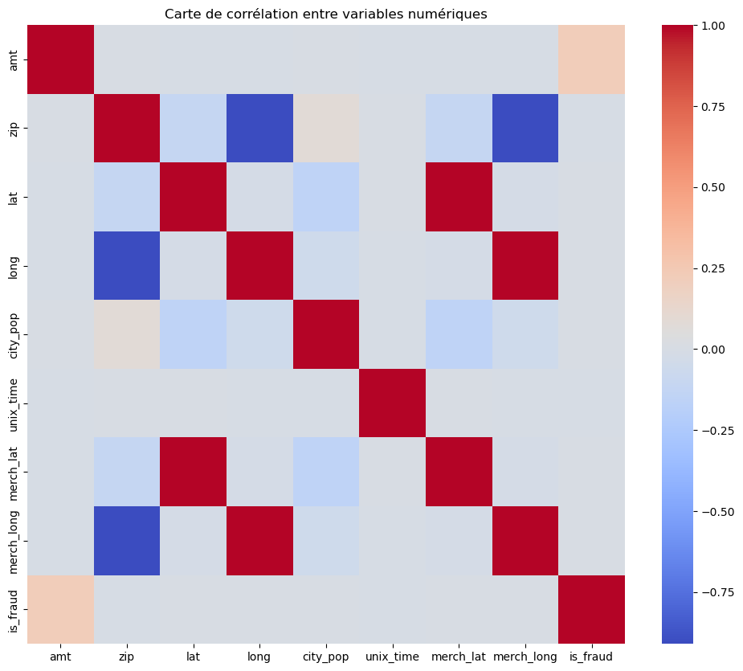
1-Dataset Final
Background: Simulated dataset covering two years of banking transactions (2019-2020)
Volume: More than 1.2 million transactions, involving 1,000 customers and 800 merchants
Challenge: Effectively identify rare frauds while minimizing false positives

Slide 4
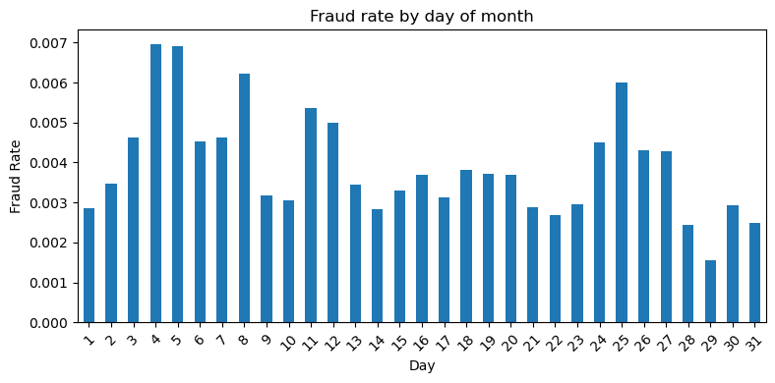
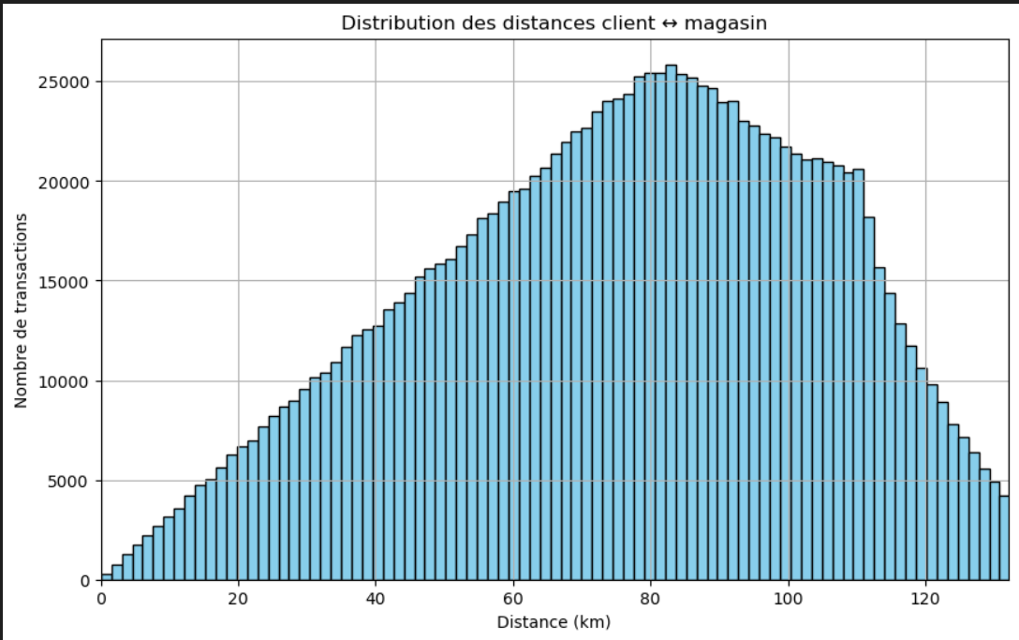
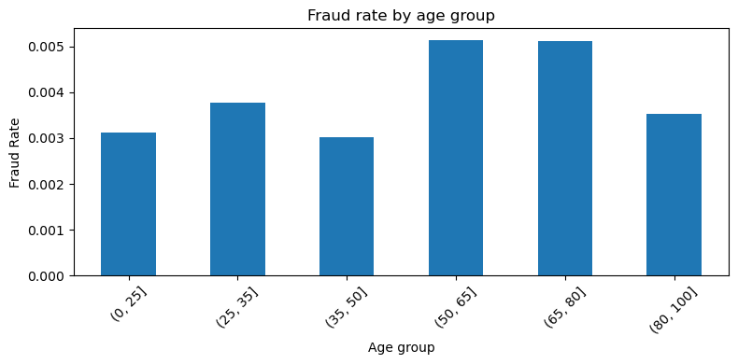
2- Exploratory Analysis (EDA)
Fraud represents barely 0.58% of cases, resulting in a marked imbalance.
Temporal analysis: fraud peaks observed between 10 p.m. and 2 a.m.
Geographic analysis: Low-population postal codes are more vulnerable
Behavioral analysis: sensitive categories ('shopping_net', 'grocery_pos')

Slide 5
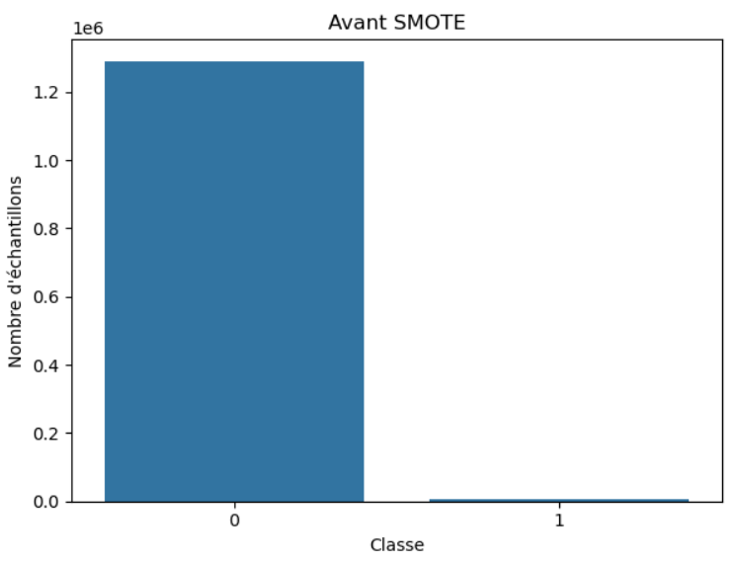
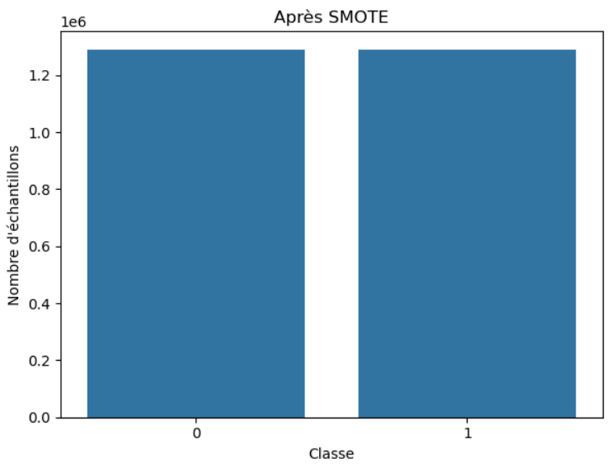
3- Pretreatment & Balancing
No missing values in the dataset
Standardization of transaction amounts to harmonize data
SMOTE applied to balance the training game (cheating/non-cheating)

Slide 6
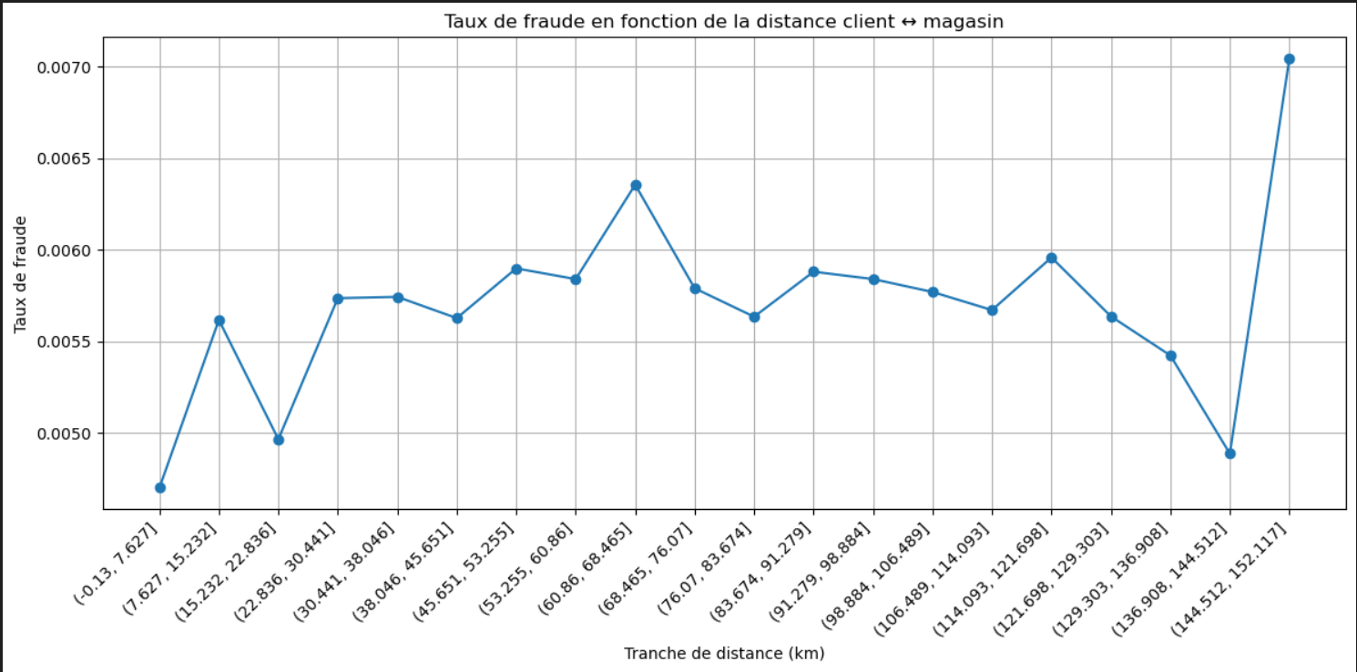
4- Feature Engineering
Creating key variables:
Customer ↔ merchant distance (GPS coordinates)
Temporal spikes (<60s)
Hours/days, age, occupation, city population
Binning (age, population) and categorization of amounts (round, atypical)

Slide 7
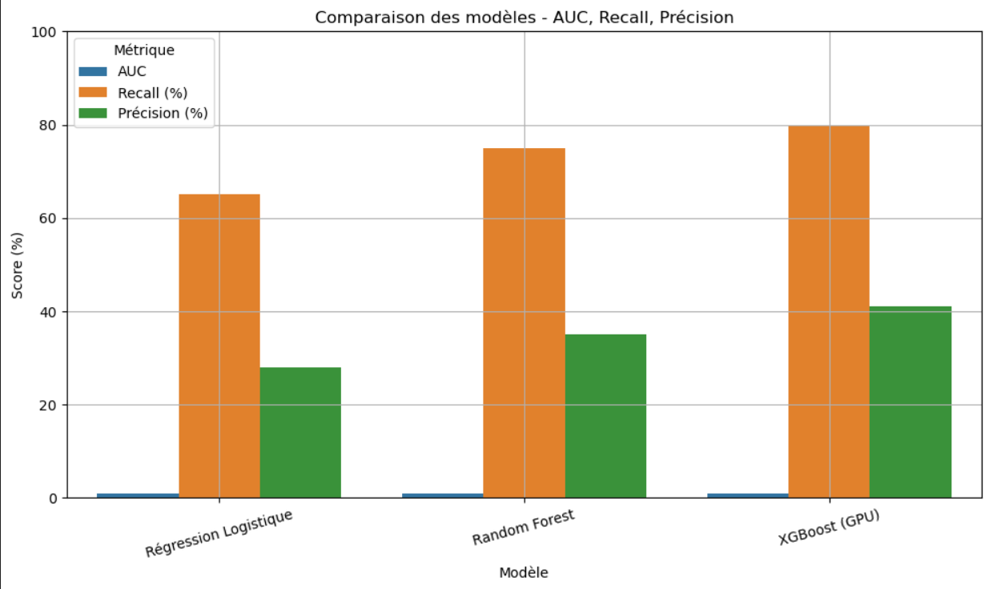
5- Modeling & Evaluation
Models tested:
Logistic Regression: Baseline
Random Forest: good recall but slower
XGBoost (GPU): Best overall results
Actual (test) results for XGBoost :
AUC = 0.98, Recall = 80%, Precision = 41%

Slide 8
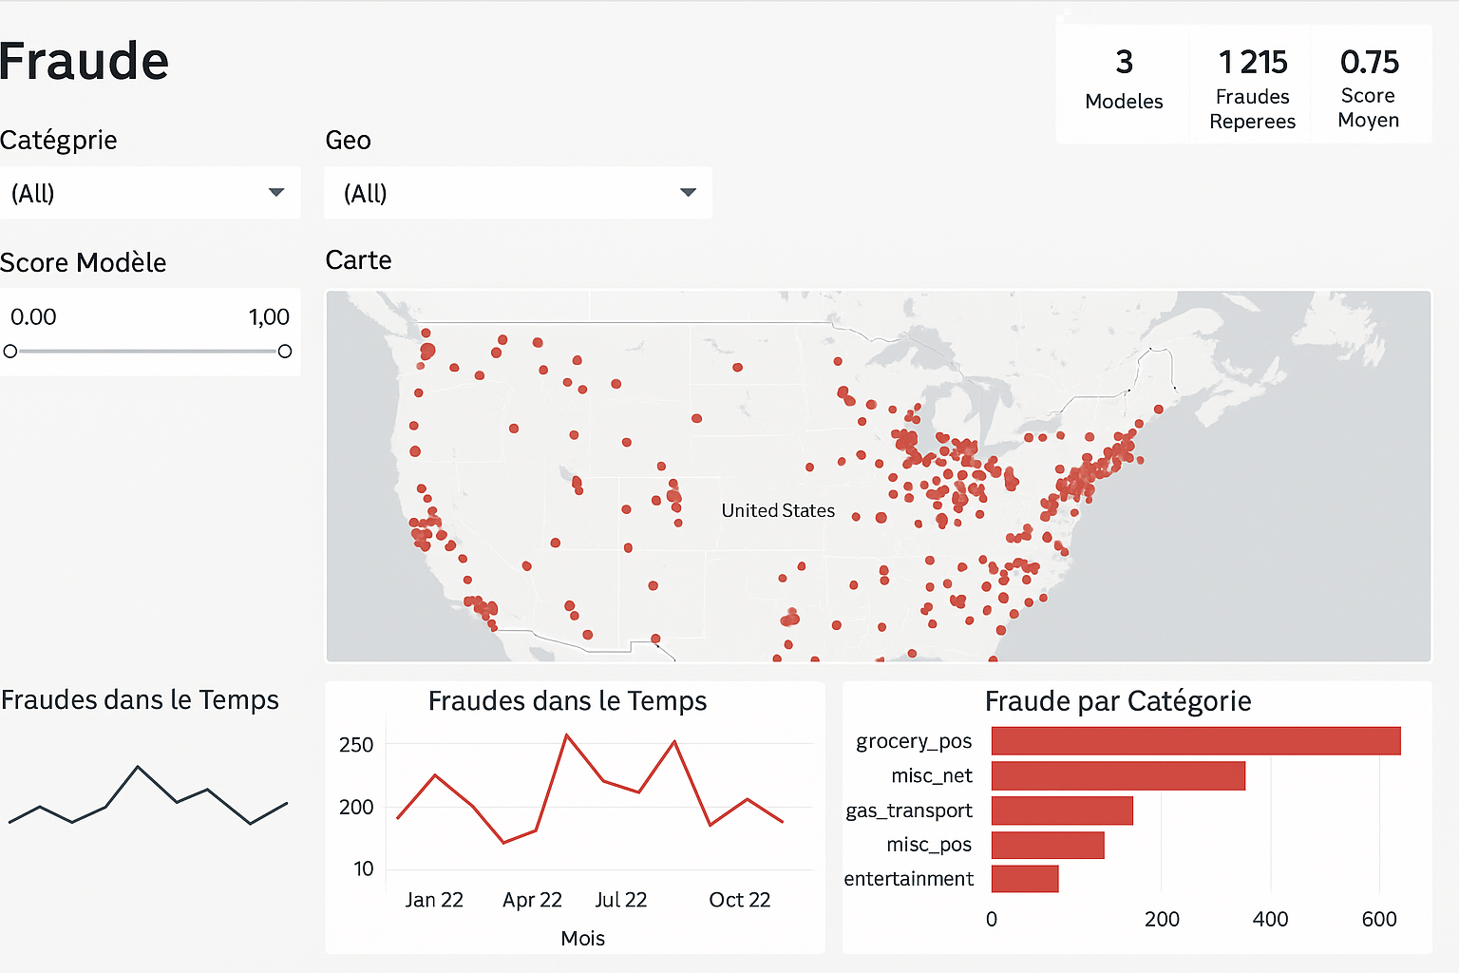
6- Visualization & Dashboard
Visualizations: Matplotlib, Seaborn ,Folium for mapping
PowerBI: interactive dashboard with filters (category, geo, model score)
Business view to facilitate monitoring

Slide 9
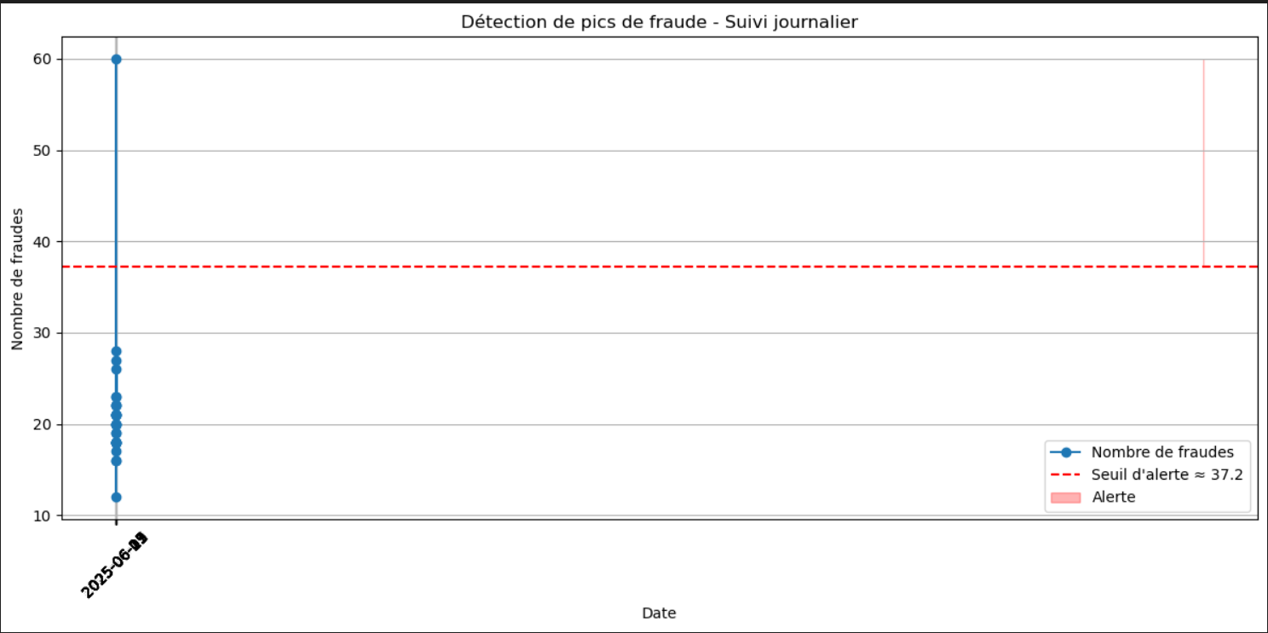
7- Prevention
Proposed strategies:
Dynamic thresholds on time, distance, merchants
Alert in case of spikes or sudden changes in behavior
Additional data suggested:
Fingerprinting, merchant blacklist, network analysis
Data type | Examples | Main utility
Fingerprinting Device | Device ID, OS type, resolution, browser, session ID | Identify devices shared between accounts
User behavior | Session time, clicks, typing speed, mouse movements | Detect unusual or suspicious behavior
Blacklist | Risky merchants, banned IPs, fraudulent emails | Block or alert upon detection of a known element
Graph analysis | Shared cards/IDs, common IPs, similar addresses | Identify organized groups or related frauds
Geolocation | Customer distance ↔ transaction, country/time inconsistencies | Alert in case of impossible movements
User history | Purchase frequency, usual times, usual amounts | Detect behavioral disruptions

Slide 10
8-Top 5 protections through knowledge
1. Know how to recognize a fraudulent site
Check the URL, the presence of HTTPS, and avoid poorly translated or overly aggressive sites.
2. Know phishing techniques
Never click on a suspicious email link (banks, fake fines, etc.).
3. Understand how two-factor authentication (2FA) works
Know how to activate it and why it blocks most fraud.
4. Be aware of weak signs of fraud
Repeated very low amounts, unusual location, activity outside of hours.
5. Know your rights and reflexes in the event of fraud
Know that you can dispute a transaction and that the bank has obligations.

Slide 11
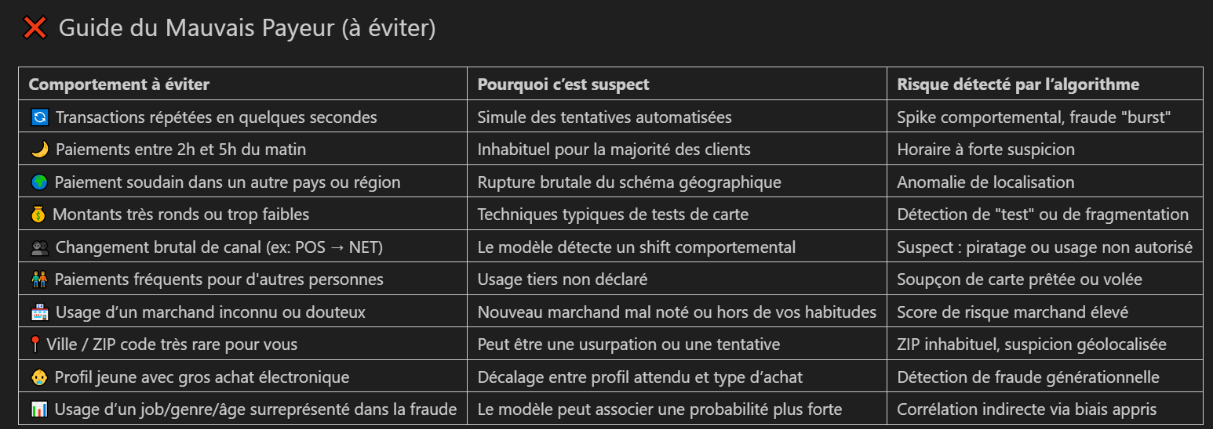
9-Behavioral Guide

Slide 12
THANKS !
Questions
Useful links (GitHub, Notebook, Template)

